Slide 1

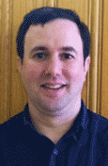
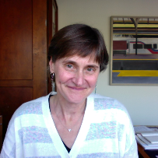
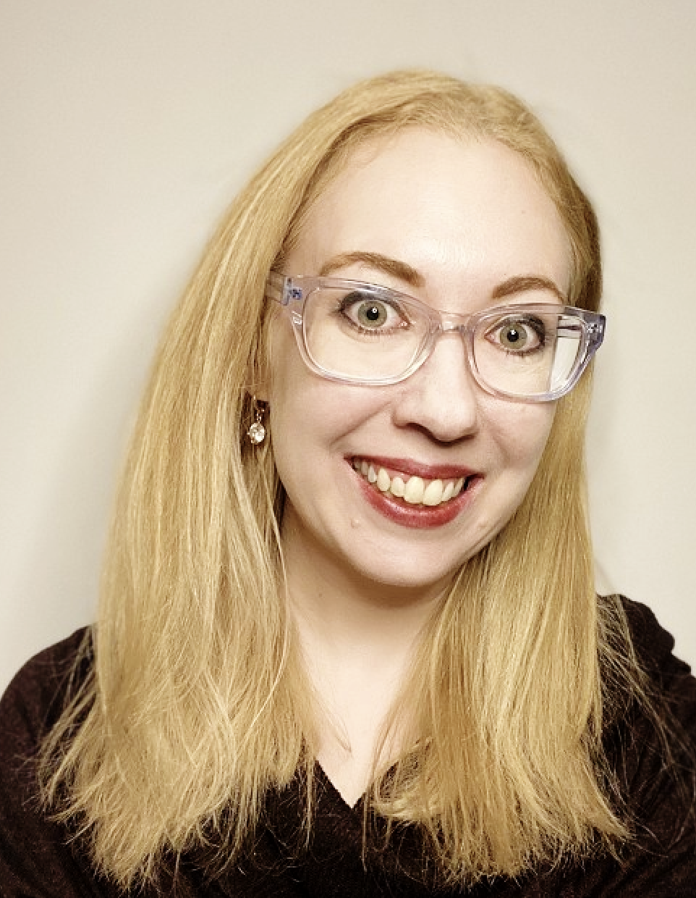
Graduate Training in Medical Science (GTMS)
Director and mentor
Jonathan Katz
jpkatz@upenn.edu
Director and mentor
Jenni Punt
punt@vet.upenn.edu
Administrator and co-mentor
Anne-Cara Apple, annecara@upenn.edu

Slide 2
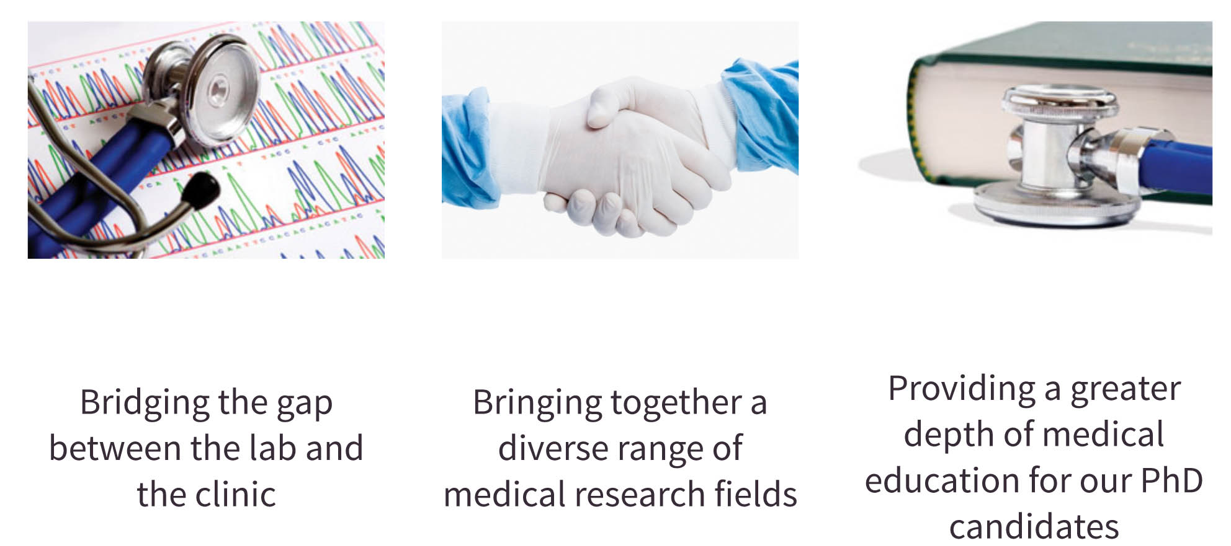
What is GTMS about?

Slide 3
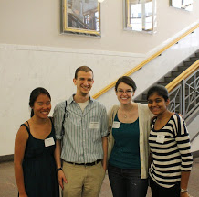
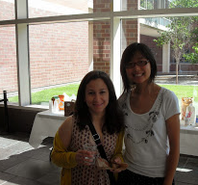
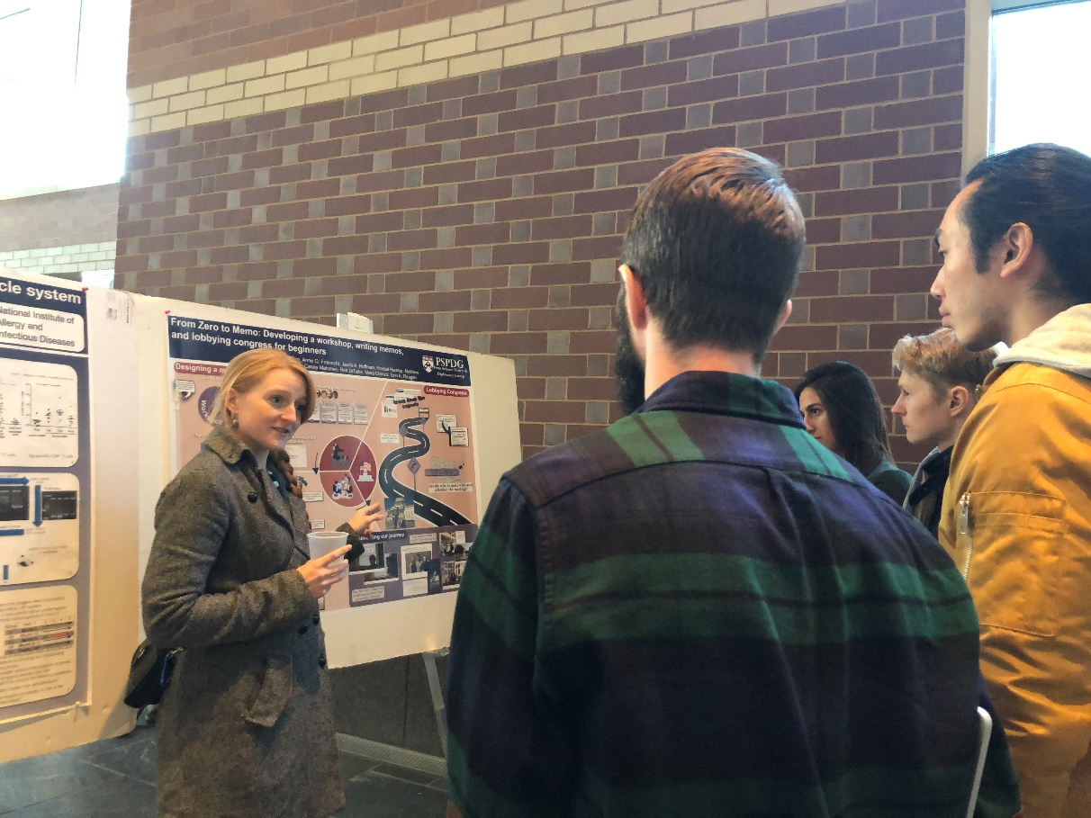
Our GTMS Program
40+ students from almost all BGS grad groups
10-15 students admitted each year

Slide 4
Program Overview
Clinical/Translational Coursework
Monthly GTMS Seminar Series
Annual Multi-School Symposium
Clinical Clerkship

Slide 5
CUrriculum
Develop a curricular plan with your GTMS mentors
TWO courses relevant to your translational interests that also fulfill your graduate group (preferentially elective) requirements.
BIOM 502: Molecular Basis of Disease – specifically for GTMS students
ONE BENCH-TO-BEDSIDE ELECTIVE

Slide 6
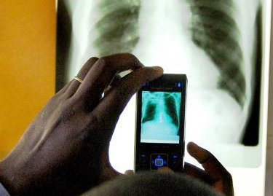
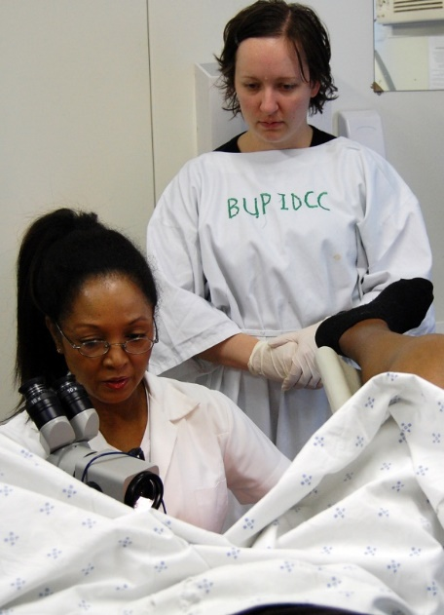
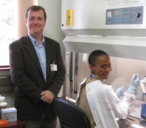
Clinical Clerkship
  Goals:
    Gain insight into drug development, medical care delivery and/or patient-oriented research.
    Expand professional network.
  40 hours in a clinical setting: Flexible and based on your interests
      Attend medical rounds
      Shadow physicians and veterinarians; observe surgeries
      Observe autopsies, necropsies
      Gain familiarity with clinical laboratory diagnostics
      Gain exposure to Penn’s global health clinics
      Gain exposure to clinical trial
  Keep a journal of your clinical experiences
  Present your experience at the GTMS Seminar

Slide 7
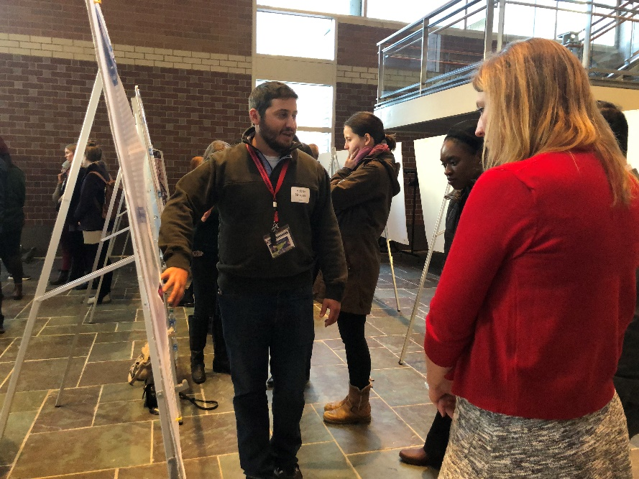
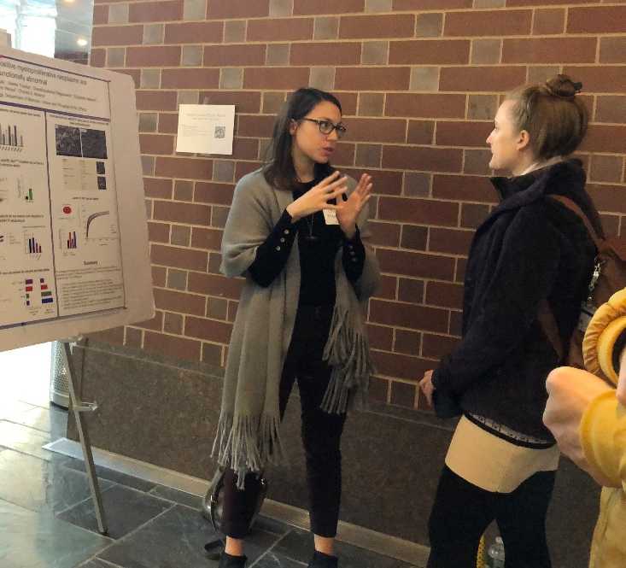
Annual Multi-School Student Symposium
Rotating symposium with Harvard, Yale, Memorial Sloan Kettering, Columbia, Stonybrook and Penn PhD students
    2018-19 Yale
    2019-20 Penn
    2021-2022 StonyBrook
Notes:
This year at Yale, next year at Penn

Slide 8
What are our graduates doing?
Principal Scientist and Director of Scientific Licensing, Janssen Pharmaceuticals
Associate Director of Research and Senior Scientific Advisor, Castleman Disease Collaborative Network
Cancer Prevention Fellow, National Cancer Institute
Assistant Professor of Pathology, Virginia Commonwealth University
Senior Analyst for Corporate Development, ACADIA Pharmaceuticals
Postdoctoral Fellow, Salk Institute
Post-doctoral fellow, Boehringer Ingelheim
Post-doctoral fellow, Clinical Chemistry, Baylor College of Medicine

Slide 9
Why join GTMS?
The future of biomedical research depends upon:
  The involvement of the basic science community in addressing important, unmet clinical needs to improve human health
  Communication and collaboration among physicians, veterinarians and basic scientists
You!

Slide 10
Student perspective
ALEX INDEGLIA
Laura pinheiro
  From Rhode Island
  Undergrad: University of Virginia
  Graduate group: BMB
  Thesis mentor: Maureen Murphy
  From Brazil/Florida
  Undergrad: University of Florida
  Graduate group: BMB
  Thesis mentor: Katy Wellen
Why we chose to apply to GTMS:
Interest in translational research
Wanted to learn how to ask clinically relevant questions in basic research
Supplement our PhD training with broader medical knowledge
Skills acquired by being in GTMS:
Developed connections by networking with faculty at Penn and outside of Penn
Introduction to a diverse range of medical conditions and their accompanying research
Really looking forward to the clinical clerkship! ☺ (also one of the main reasons we joined!)

Slide 11
GTMS Monthly Seminar
An informal monthly gathering of GTMS students.
Topics and speakers are selected by 2nd year students and include investigators sharing their experiences and expertise in:
    Startup and Entrepreneurship
    Patent and Intellectual Property
    Drug Development
    Clinical Trials: design, monitoring and data analysis

Slide 12
GTMS Monthly Seminar Series 2020
September – Dr. David Fajgenbaum, Perelman School of Medicine
October – Dr. Chris Bennett, Perelman School of Medicine
November – Dr. Kathryn Wellen, Perelman School of Medicine
December – Dr. Jennifer Heemstra, Emory University
January – Bobby Norgard, GTMS member, PhD candidate in Cancer Biology
February – Dr. Stephen Emerson, Columbia University
March – Dr. Sara Cherry, Perelman School of Medicine
April – Dr. Alexander Marson, UCSF
May – Dr. Saul Priceman, T Cell Immunotherapy Program, City of Hope

Slide 13

Sounds great, but can I still apply?
Accepting applications until September 13th
Administrator:
Anne-Cara Apple, annecara@upenn.edu
Directors:
Jonathan Katz, jpkatz@upenn.edu
Jenni Punt, punt@vet.upenn.edu
Student Leaders:
Alex Indeglia, indeglia@pennmedicine.upenn.edu
Laura Pinheiro, laurapin@pennmedicine.upenn.edu
https://pixabay.com/

Slide 14
Thanks to our GTMS students
current
and former
Website: http://www.med.upenn.edu/gtms

